Slide 1
Fraud News Detection with GNN
By :
Yash Shankar Tiwary

Slide 2
Need for Such Model
Disinformation and fake news have posed detrimental effects on individuals and society in recent years, attracting broad attention to fake news detection. The majority of existing fake news detection algorithms focus on mining news content and/or the surrounding exogenous context for discovering deceptive signals; while the endogenous preference of a user when he/she decides to spread a piece of fake news or not is ignored

Slide 3
Advantages and Disadvantages of Fake News
Advantages
Disadvantages
Advertisers take the Advantages of Fake News
Influencers also take benefits of Fake News
Political Warfare
Fun and Entertainment
Change in Public Opinion
Defamation is among the disadvantages of fake news
False Perception
Fake News may lead to Social Unrest
Fake News Cost lives

Slide 4
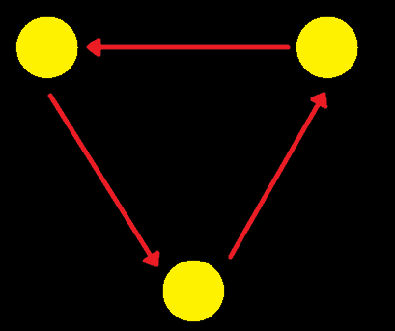
What is a Graph?
A Graph is the type of data structure that contains nodes and edges. A node can be a person, place, or thing, and the edges define the relationship between nodes. The edges can be directed and undirected based on directional dependencies. In the example below, the blue circles are nodes, and the arrows are edges. The direction of edges defines dependencies between two nodes.

Slide 5
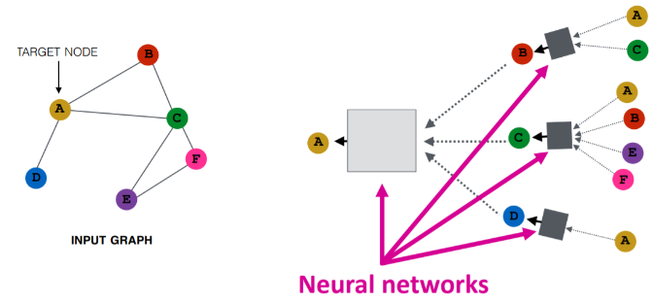
What is a Graph Neural Network (GNN)?
Graph Neural Networks are special types of neural networks capable of working with a graph data structure. They are highly influenced by Convolutional Neural Networks (CNNs) and graph embedding. GNNs are used in predicting nodes, edges, and graph-based tasks.

Slide 6
Why GNN?
Although significant effort has been applied to fact-checking, the prevalence of fake news over social media, which has profound impact on justice, public trust and our society, remains a serious problem
In particular, we concentrate on two questions:
(1) Without relying on any text information, e.g., tweet content, replies and user descriptions, how accurately can GNNs identify fake news?

Slide 7
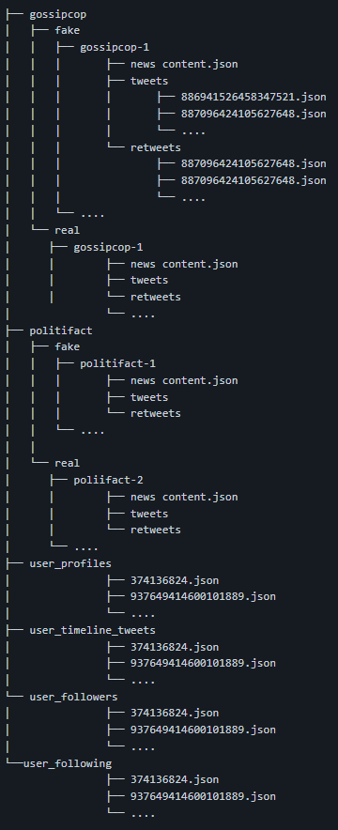
About the Dataset
news_articles : This option downloads the news articles for the dataset.
tweets : This option downloads tweets objects posted sharing the news in Twitter. This makes use of Twitter API to download tweets.
retweets: This option allows to download the retweets of the tweets provided in the dataset.
user_profile: This option allows to download the user profile information of the users involved in tweets. To download user profiles, tweet objects need to be downloaded first in order to identify users involved in tweets.
user_timeline_tweets: This option allows to download upto 200 recent tweets from the user timeline. To download user's recent tweets, tweet objects needs to be downloaded first in order to identify users involved in tweets.
user_followers: This option allows to download the user followers ids of the users involved in tweets. To download user followers ids, tweet objects need to be downloaded first in order to identify users involved in tweets.
user_following: This option allows to download the user following ids of the users involved in tweets. To download user's following ids, tweet objects needs to be downloaded first in order to identify users involved in tweets.
Link : https://github.com/KaiDMML/FakeNewsNet

Slide 8
Implementation

Slide 9
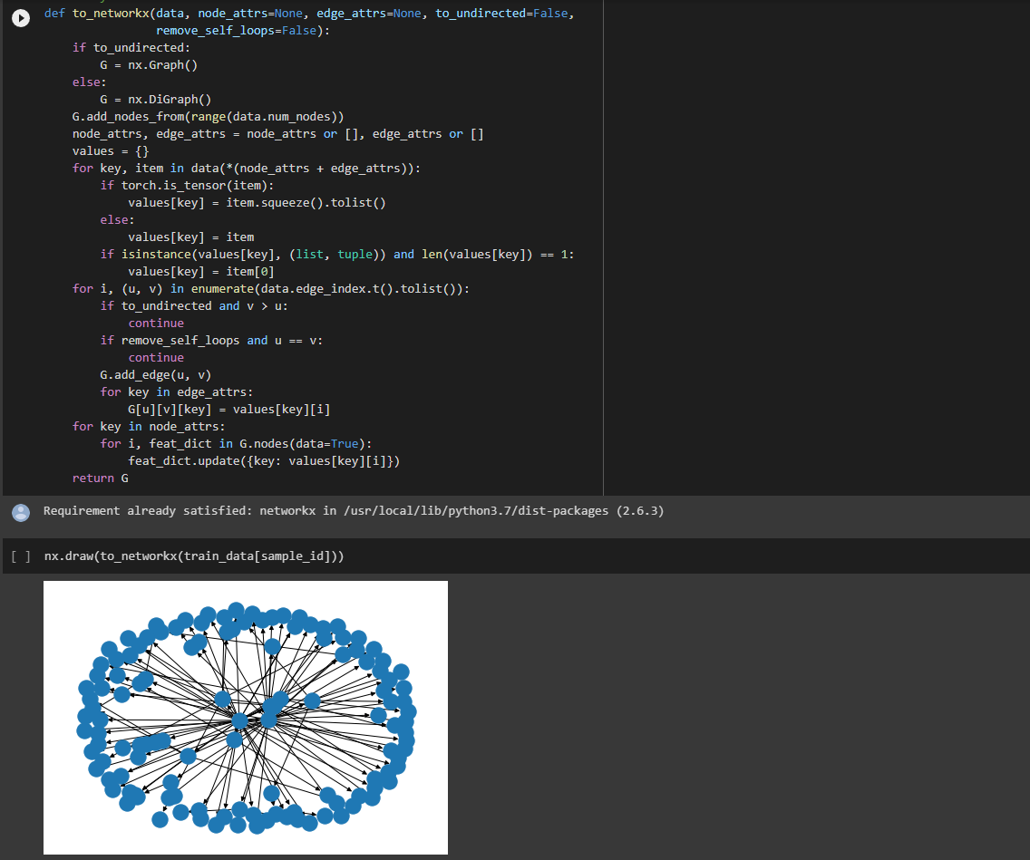

Slide 10
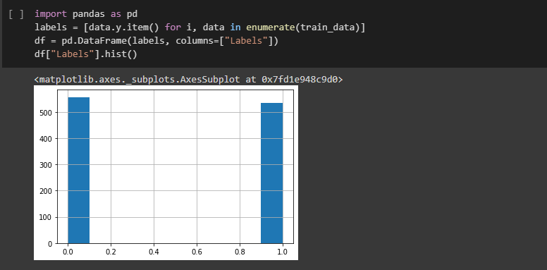

Slide 11
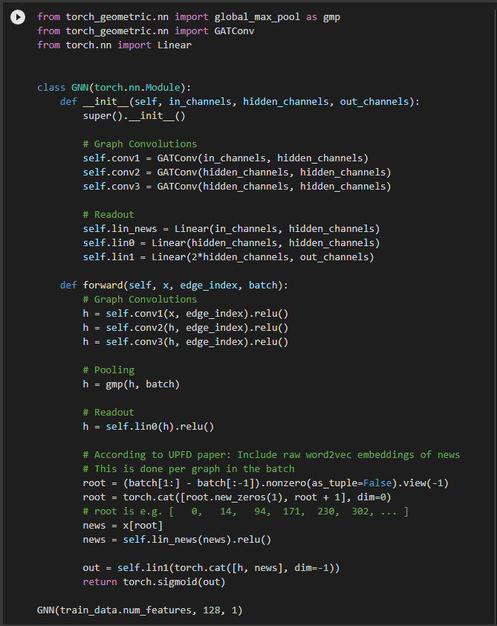

Slide 12
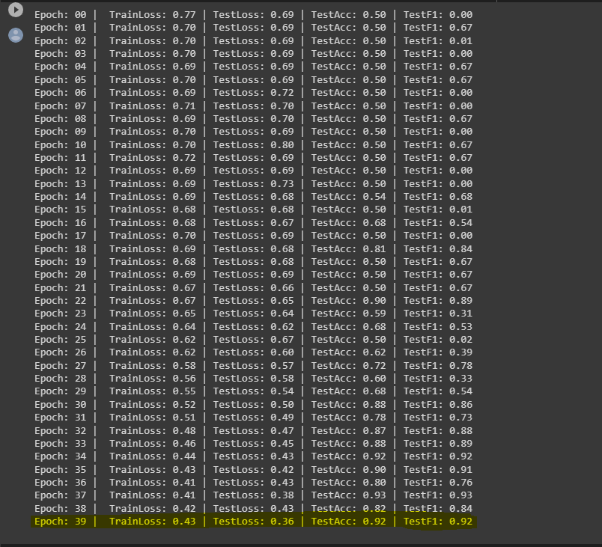
Results

Slide 13
